Slide 1
Financial aspects of the University Research Grants

Slide 2
Outline
Regulatory Framework
Types of Research Grants
Procedure for URG
URG Budgets
Procurement Procedure
Procurement Methods
Advances

Slide 3
Regulatory Framework
Financial Regulations
Circulars
Finance Circulars
UGC Circulars/ Est Circulars
Procurement Guidelines/ Manuals
By Laws

Slide 4
Research Grants
URG (Funded by treasury)
Foreign Research Grant
Local – Other (Funded by various research Institutes)

Slide 5
Procedure applicable for University Research Grants
Inform the faculty-wise allocation for University Research Grants in each year by the Council and Academic Unit.
Call for Research Proposals by the Faculty Research Committees.
Select, recommend and forward the research proposals to be funded within the allocation given to each faculty by the respective Faculty Research Committees.
Obtain the approval of the Senate Research Committee.
Obtain the recommendation of the Finance Committee and the approval of the Council for the budgets of each research grant.

Slide 6
Contd..
Transferring grant funds to the Accounts Units of the respective faculty by the Research, Funds and Publications Unit.
Grant funds are managed by the Accounts Unit of the respective faculty and the grantees should make all their requests for advances, reimbursements and procurements of chemicals, equipments, stationery, etc through the Supervisor and the Head of the Department as per the approved budget.

Slide 7
Grantees should submit Bi-annual progress reports and completion reports including the financial progress to the Faculty Research Committee in the specified formats which will then be forwarded to the Senate Research Committee for approval
Transferring any remaining funds in the grant account on completion of the research or expiration of the duration including any extensions given.
Grantees shall refund the funds disbursed to the grantee in case of any default in completing the research within the duration of the grant.

Slide 8
Budgets- Eg

Slide 10
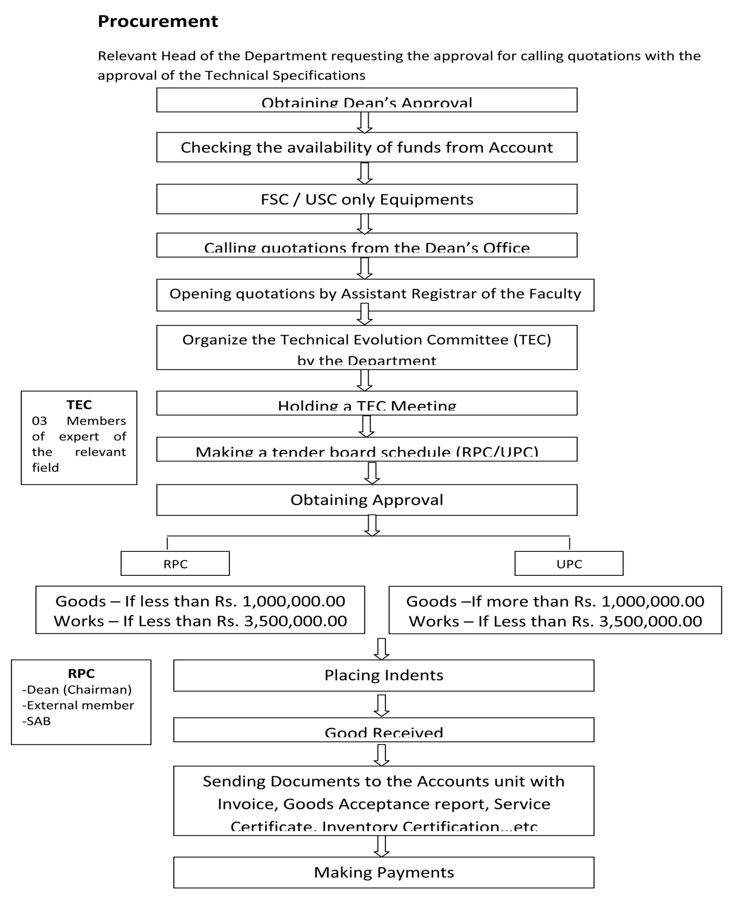

Slide 11
Procurement Methods
Shopping -07/14 Days
AO –With 3 sealed Quotations
RPC- with 5 sealed quotations
Direct Contracting
AO-Goods <100,000
Dean – 15.000*4 Monthly
Repeat Orders
Within 6 Months, Maximum 50%,Price, Approval

Slide 12
Advances
Requirements (Estimate, Advance request form, Approval request letter, Voucher etc.)
Limits
Dean- Rs.50,000
VC -Rs. 100,000

Slide 13
Thank you

