Slide 1
Mediastinum and Heart
Sanjaya Adikari
Department of Anatomy

Slide 2
Mediastinum

Slide 3
Mediatinum
Mediastinum is the space between the two lungs
It is bounded
superiorly by the superior thoracic aperture
inferiorly by diaphragm
anteriorly by the manubrium and sternum
posteriorly by the vertebral column
laterally by the two lungs

Slide 4
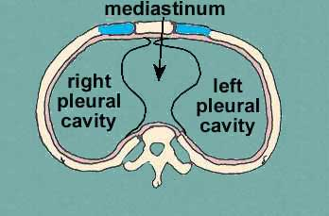

Slide 5
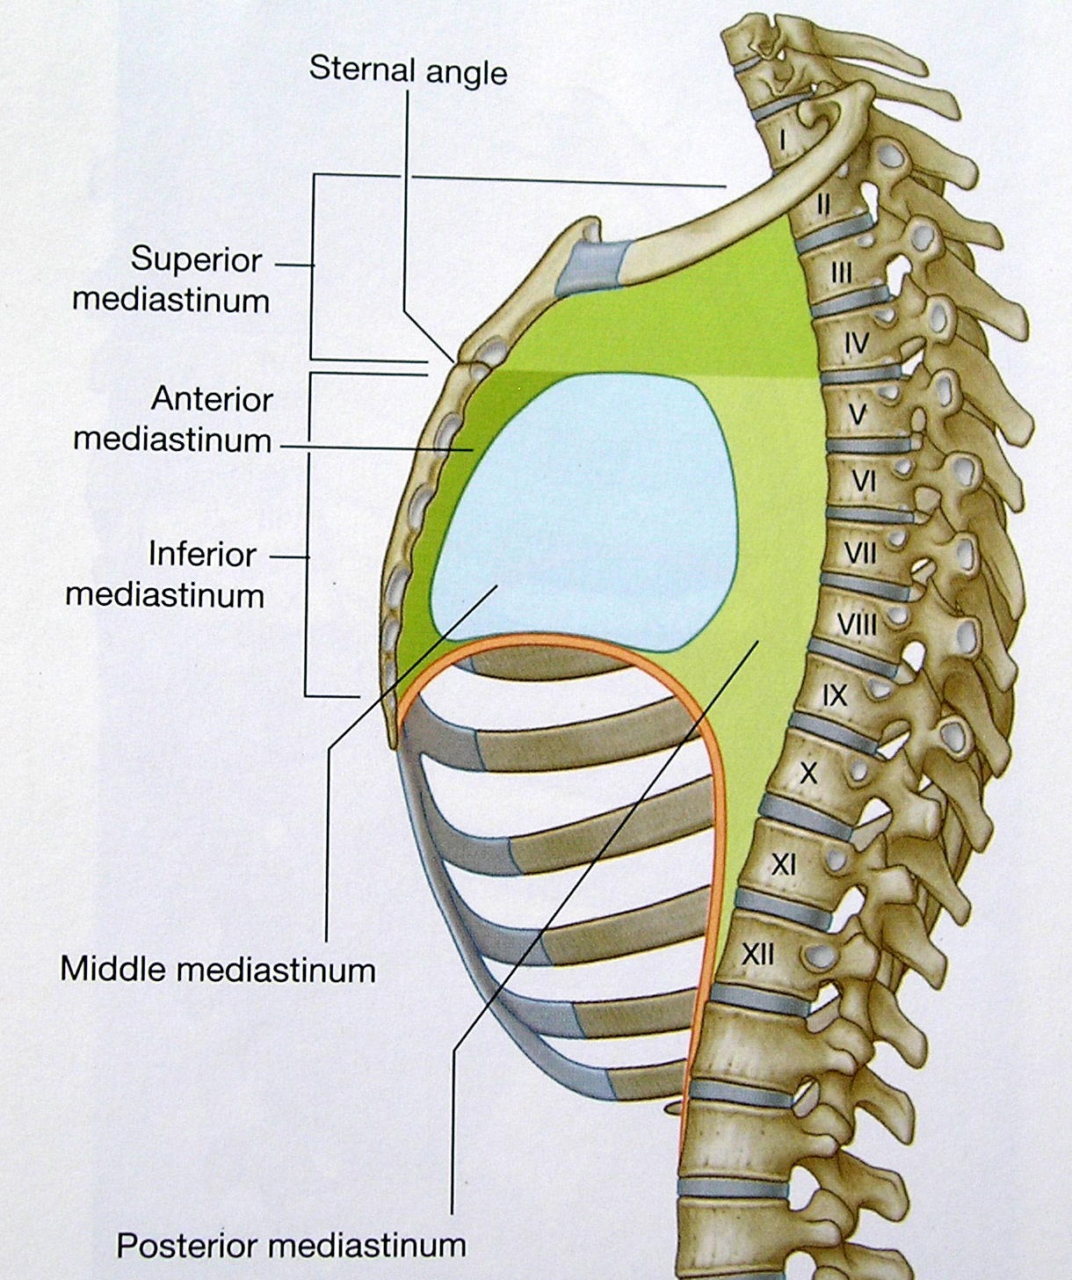
Divisions of the mediastinum
Name the structures present at the plane passing through sternal angle

Slide 6
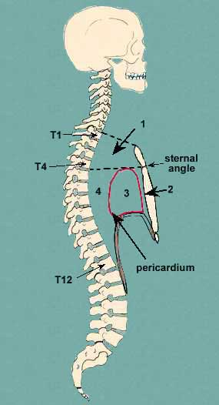
Superior mediastinum
Inferior mediastinum
Anterior mediastinum
Middle mediastinum
Posterior mediastinum

Slide 7
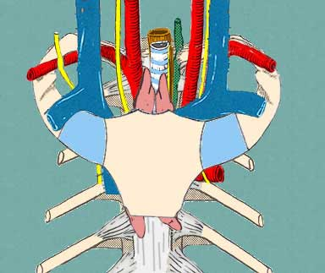
Superior mediastinum

Slide 8
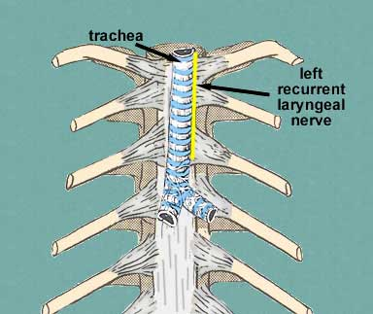
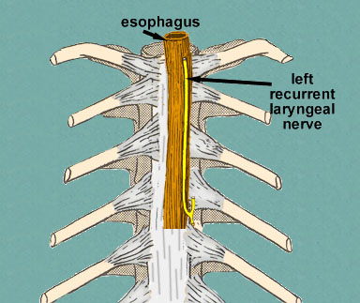

Slide 9
Superior mediastinum
What are the boundaries?
…………………………………………..
…………………………………………..
…………………………………………..
What are the contents?
…………………………………………..
…………………………………………..
…………………………………………..

Slide 10
Anterior mediastinum
What are the boundaries?
…………………………………………..
…………………………………………..
…………………………………………..
What are the contents?
…………………………………………..
…………………………………………..
…………………………………………..

Slide 11
Middle mediastinum
What are the boundaries?
…………………………………………..
…………………………………………..
…………………………………………..
What are the contents?
…………………………………………..
…………………………………………..
…………………………………………..

Slide 12
Posterior mediastinum
What are the boundaries?
…………………………………………..
…………………………………………..
…………………………………………..
What are the contents?
…………………………………………..
…………………………………………..
…………………………………………..

Slide 13
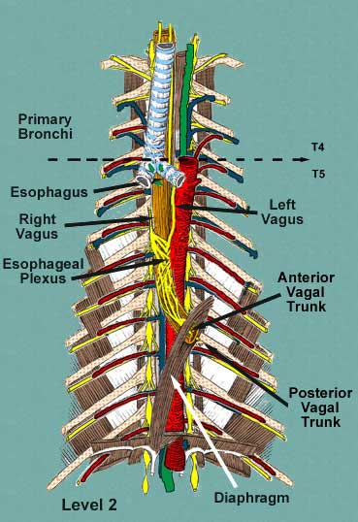
Posterior mediastinum

Slide 14
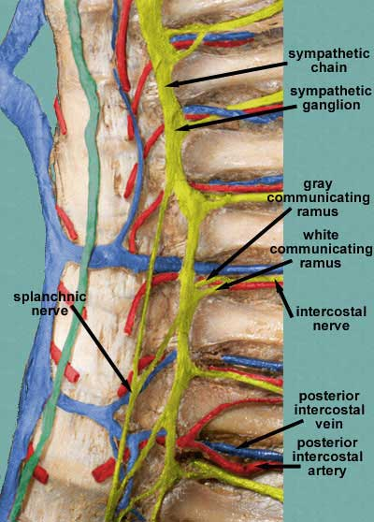
Paravertebral region

Slide 15
Heart
Covered by the pericardium
Pericardium has two layers
Fibrous pericardium
Serous pericardium
Visceral layer covering the heart surface
Parietal layer lining the fibrous pericardium

Slide 16
Heart…
Define the different borders and surfaces of the heart
Name the chambers contributing to form the surfaces and borders
Describe the blood supply of the heart

Slide 17
Borders of the Heart

Slide 18
Surfaces of the Heart

Slide 19
Chambers of the Heart

Slide 20
Orientation of the Heart & the position of coronary vessels

Slide 21
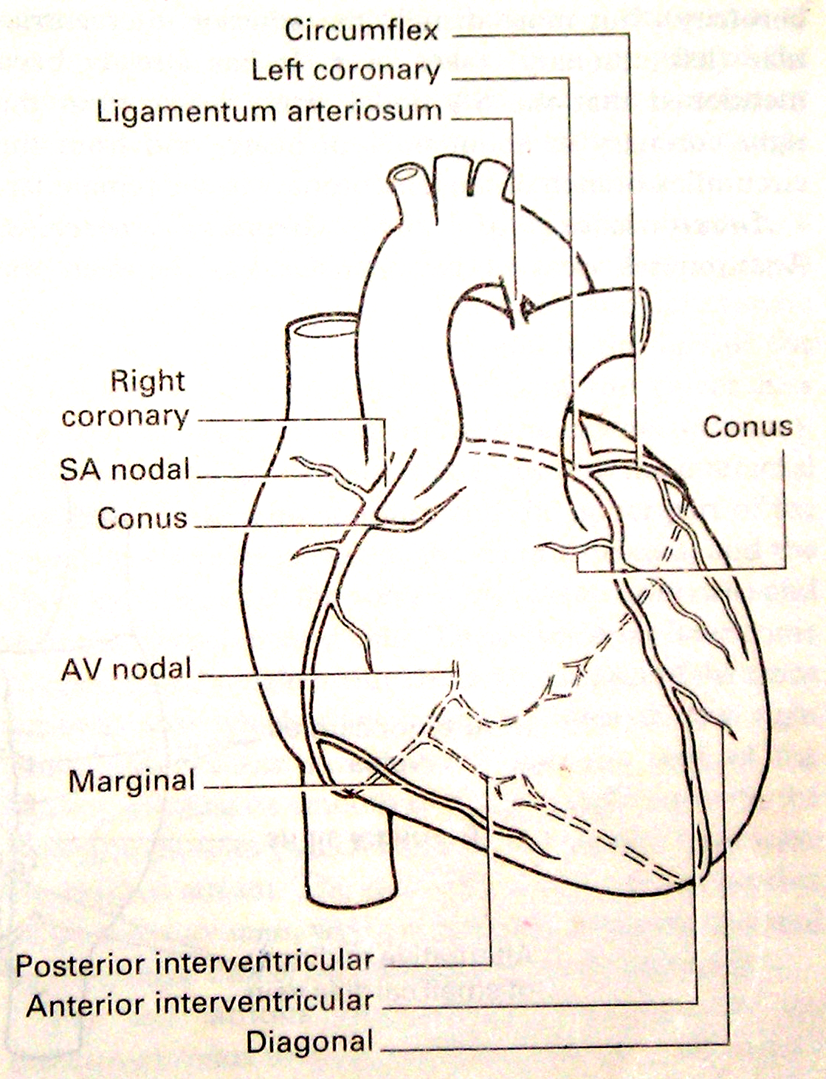

Slide 22
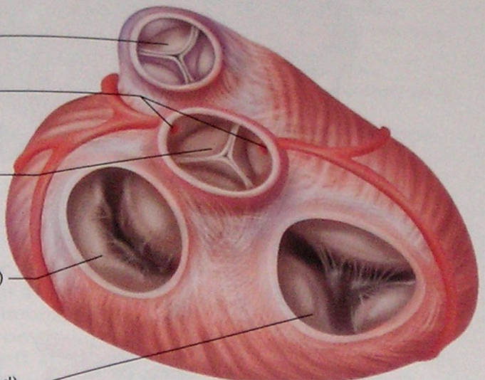
Left coronary artery
Right coronary artery

Slide 23
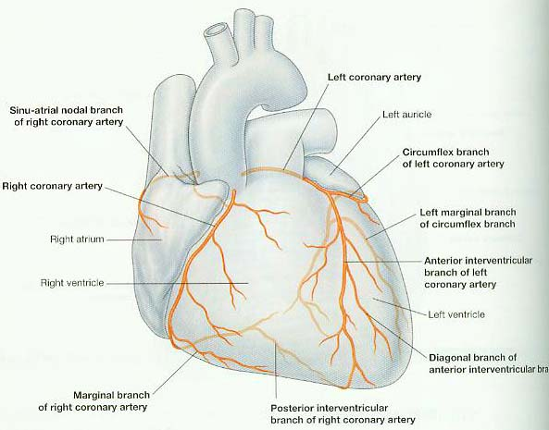
Right dominance

Slide 24
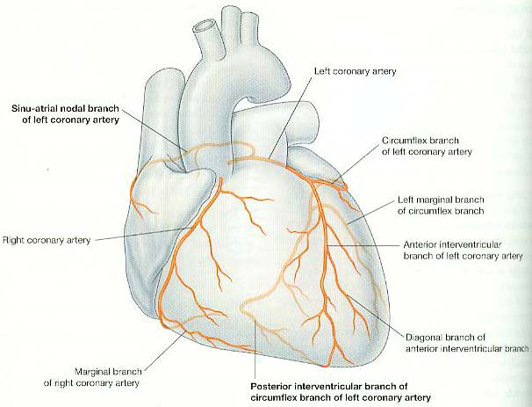
Left dominance

Slide 26
Right coronary artery (RCA)
Arises from right aortic sinus
Gives off SA nodal, right marginal, AV nodal branch and posterior interventricular branch
Dominance is decided by which of the two main coronary arteries gives rise the posterior interventricular branch
Right dominance 67 %, so most commonly the diaphragmatic surface is supplied by RCA

Slide 27
Area supplied by RCA
Right atrium
Most of right ventricle
Diaphragmatic surface of left ventricle
Posterior 3rd of interventricular septum
SA node in 60%
AV node in 80%

Slide 28
Left coronary artery (LCA)
Arises from left aortic sinus
Divides into two branches early; anterior interventricular and circumflex branches
Left dominance 33 %
Left marginal artery is a branch of the circumflex artery

Slide 29
Area supplied by LCA
Left atrium
Most of left ventricle
Anterior wall of RV adjacent to the LV
Anterior two thirds of interventricular septum
AV bundle
SA node in 40%
AV node in 20%

Slide 30
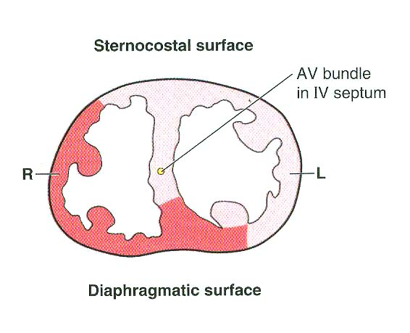

Slide 31
Coronary anastomoses
Coronary artery branches are end arteries
There are anastomoses between branches
Between posterior and anterior interventricular branches
Between RCA and circumflex artery
Between right and left conus arteries

Slide 32
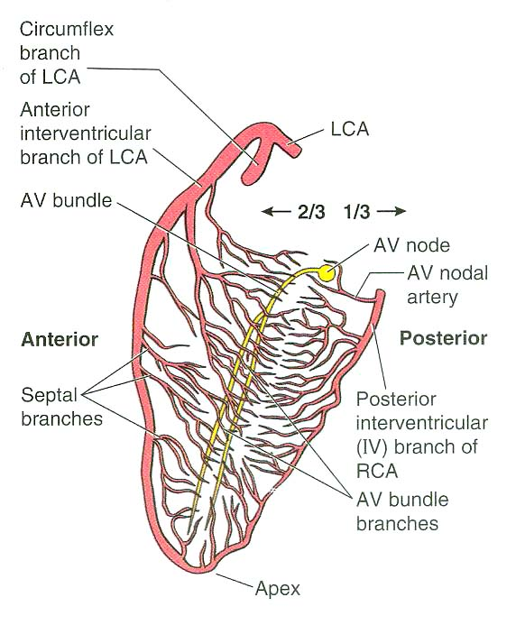

Slide 33
Coronary anastomoses… cont.
There are coronary – extracoronary anastomoses at arteriole level. Mostly pericardial vessels are involved.
Anastomoses in the interventricular septum and within the posterior wall of the left ventricle are more important than the surface anastomoses

Slide 34
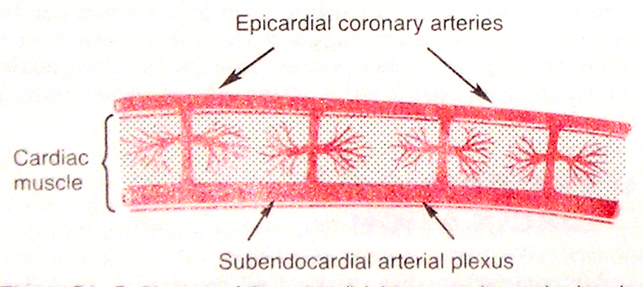
Blood supply of the heart wall
Intramuscular, penetrating arteries arising from the coronary arteries connect them to a subendocardial plexus of arteries
During systole, due to contractile forces, the blood flow to this plexus stops almost completely

Slide 35
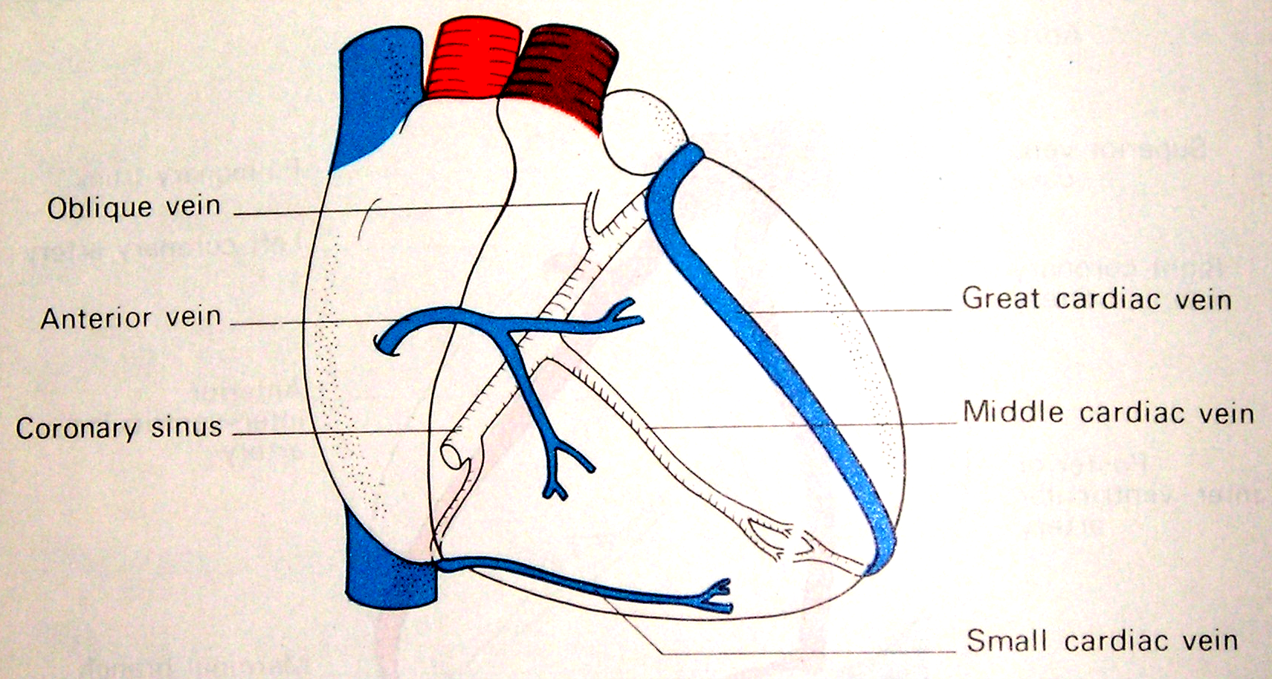
Cardiac veins

Slide 36
Cardiac veins… cont.
Main cardiac veins include,
Great, middle and small cardiac veins
Oblique vein draining left atrium
Posterior vein of the left ventricle
Anterior cardiac veins
The anterior cardiac veins drain directly into the right atrium
Other veins drain into the coronary sinus
Coronary sinus drains into the right atrium
Thebesian veins or venae cordis minimae open directly into the respective chambers of the heart

Slide 37
Summary of coronary circulation
coronary arteries
extracoronary arteries
arterioles
arterioles
capillaries
thebesian veins
any chamber
veins
anterior cardiac veins
(great/middle/small
cardiac veins)
right atrium
coronary sinus

Slide 38
Myocardial Infarction (MI)
Myocardial death due to sudden loss of blood supply.
Result of coronary artery disease and thromboembolsim
Common sites of coronary artery occlusion,
AIV branch of LCA (40-50%)
RCA (30-40%)
Circumflex branch of LCA (15-20%)

