Slide 1
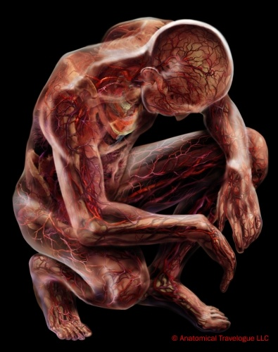
Cardio Vascular System
(Circulatory system)
Ajith Sominanda
Department of Anatomy

Slide 2
Lecture outline
Why a circulatory system ?
Arrangement of the CVS
Vascular tree-Gross Anatomy
CVS histology

Slide 3
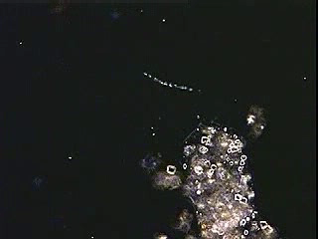
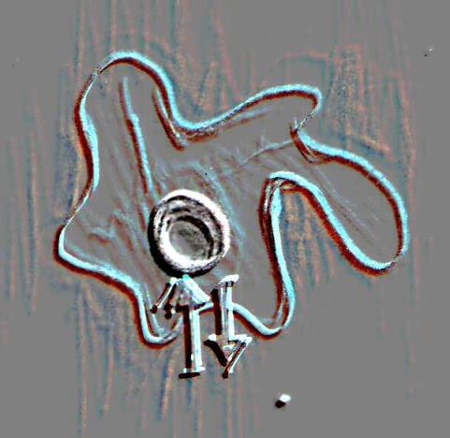
Circulatory system; Why?
Amoeba in motion
Notes:
Need of a circulatory system

Slide 4
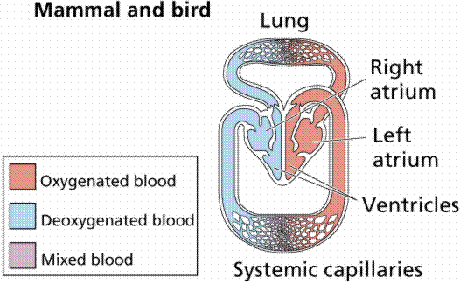
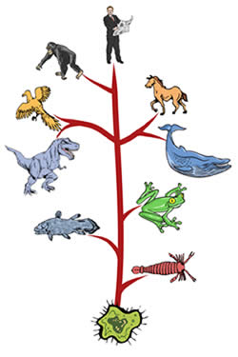
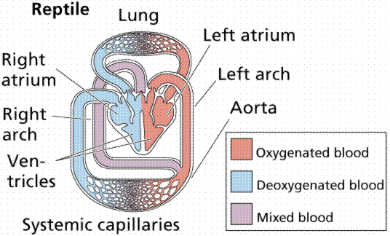
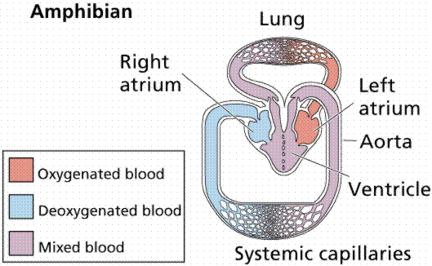
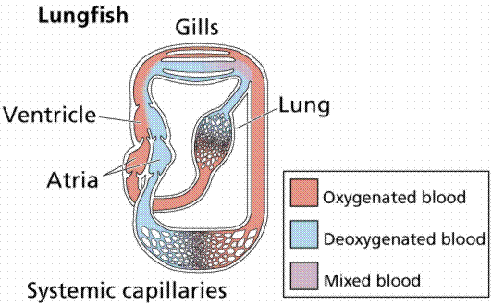
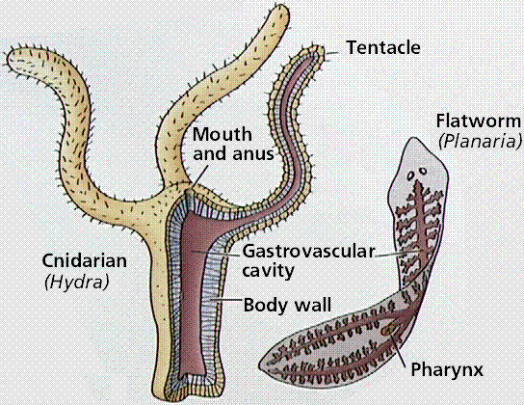
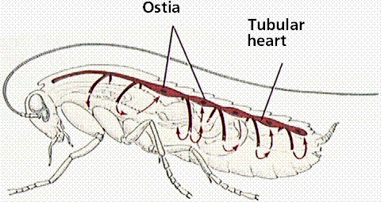
Circulatory system; Why?
Notes:
Evolution of circulatory system

Slide 5
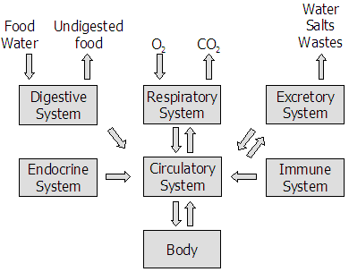
Circulatory system; Why?
Notes:
An essential Co/ordinator of other system

Slide 6
Functions of circulatory system
Transport of materials and cells by continuous movement of blood
  Gases
  Nutrients
  Waste products
  Components of immune and endocrine system
Thermoregulation

Slide 7
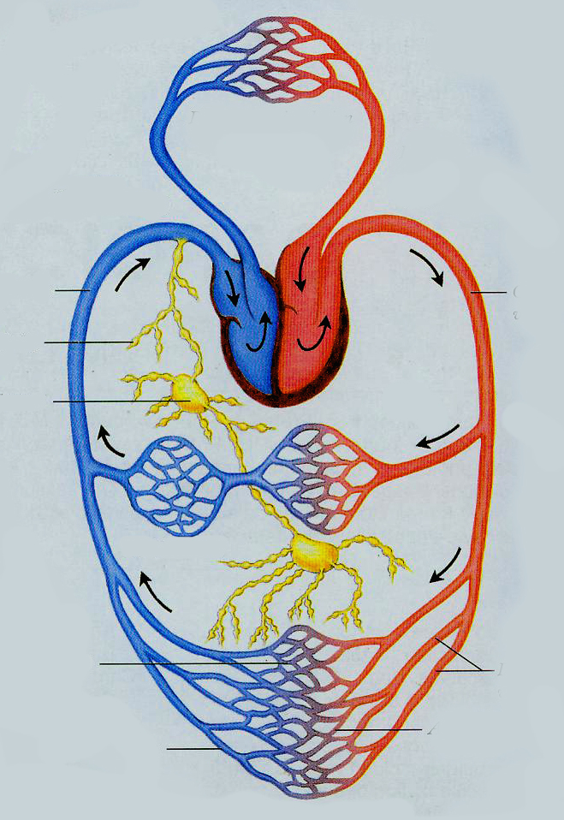
Components of human circulatory system
Blood vascular system (closed)
  Heart
  Arteries and arterioles (conduction / distributing vessels)
  Capillaries (exchange vessels)
  Venules and veins (capacitance vessels)
Pulmonary circulation
Heart: right chamber s (De-oxygenated blood)
Heart: left chambers (oxygenated blood)
Capacitance vessels
(Veins)
Conducting vessels
Lymphatics
Lymph nodes
Lymph vascular system (open)
  Lymphatics
  Lymph nodes
Distributing vessels
Venules
Arterioles
Exchange vessels
(Capillaries)
Notes:
Recalling AL & high school knowledge
Working classification

Slide 8
Vascular tree- Gross anatomy

Slide 9
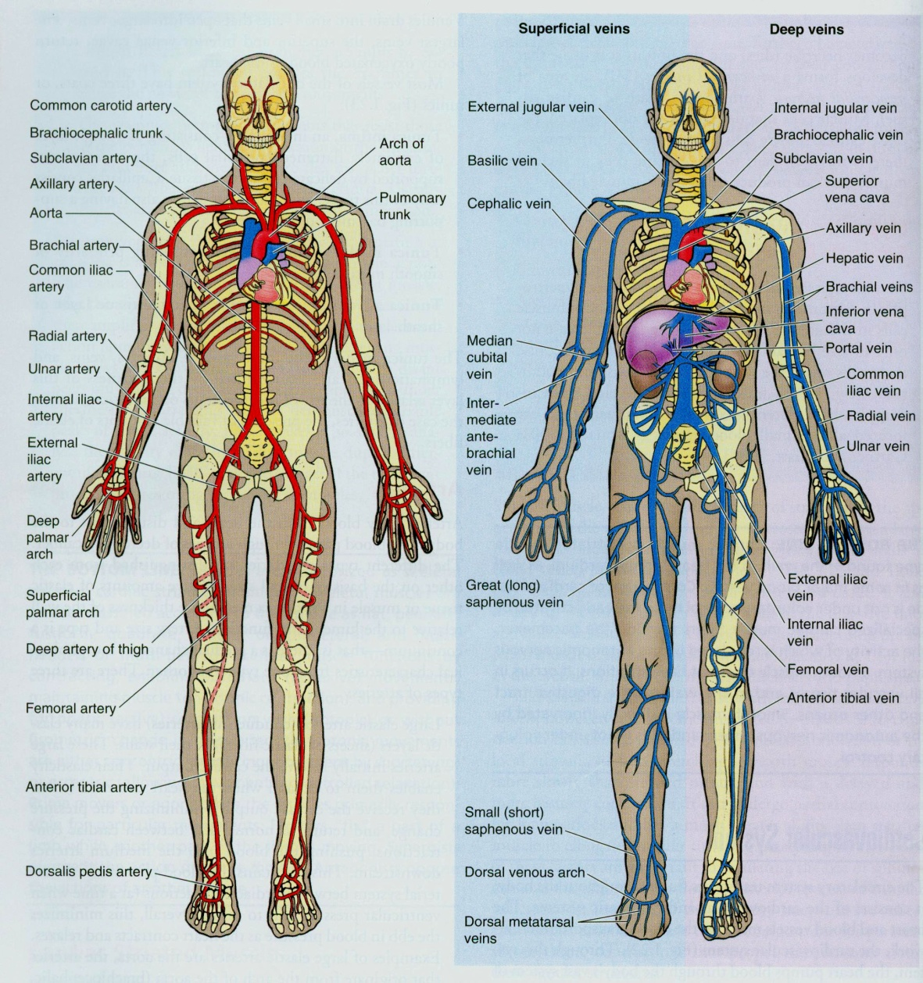
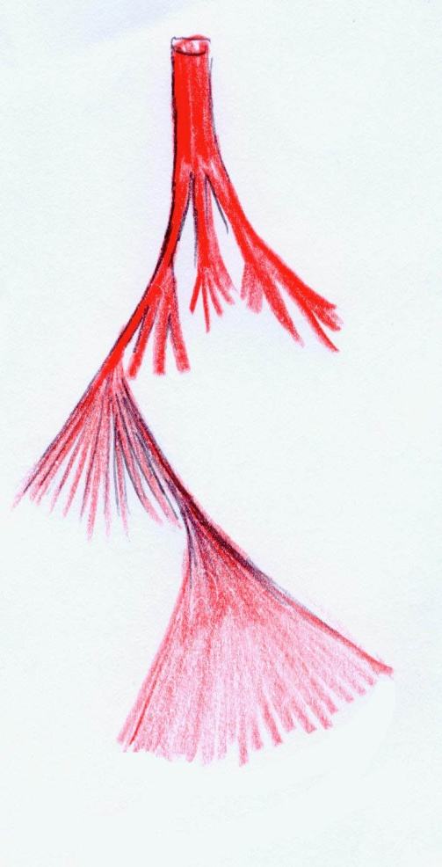
Overall arrangement
Aorta
(2-2.5 cm)
Large and medium size arteries
(100-200)
Arterioles
(4 * 10⁶ )
(<300 µm)
Capillaries
(16 * 10⁶ )
(7 µm)
Notes:
Pathway, movement of the blood starting from heart
Extensive branching pattern

Slide 10
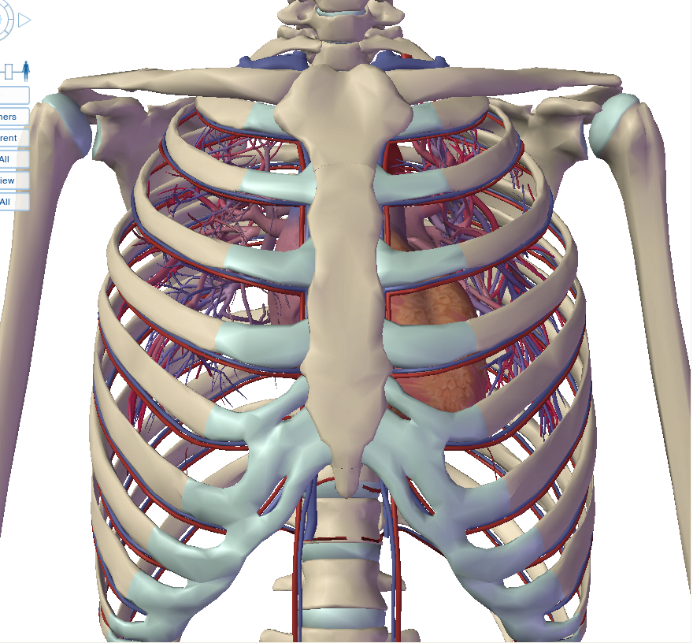
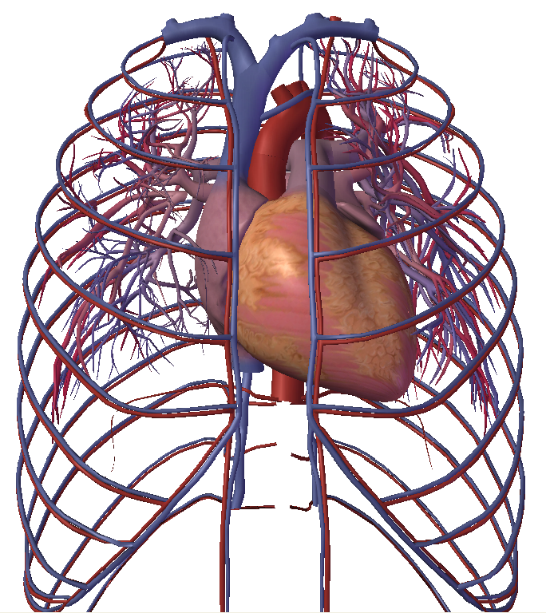
Heart, great vessels and
circulation in thorax
Arch of aorta
Superior vena cava
Pulmonary
artery
Inferior vena cava
RA
RV
LV
Intercostal vessels
Notes:
Recall the thorax dissection
Heart is a main organ in mediastinum along with its great vessels
Recall circulation in thorax

Slide 11
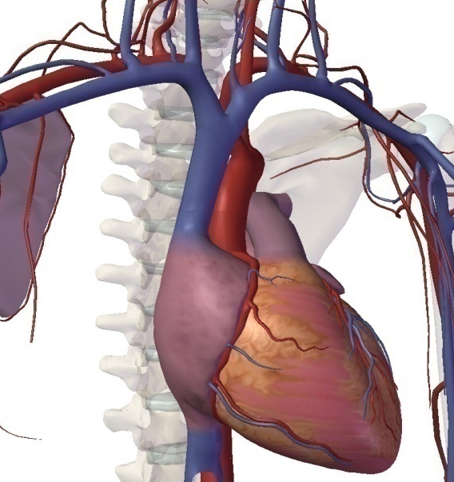
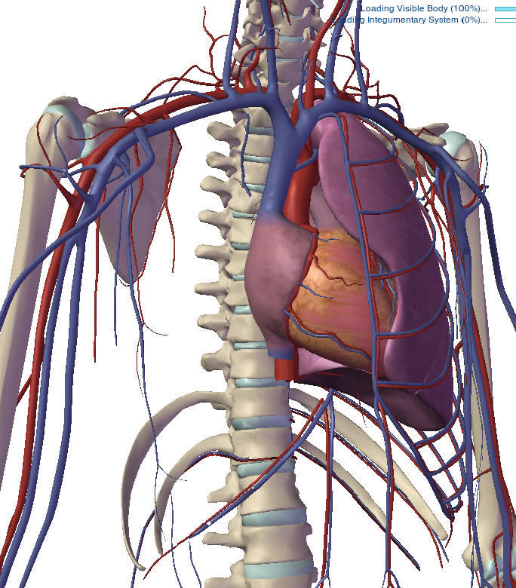
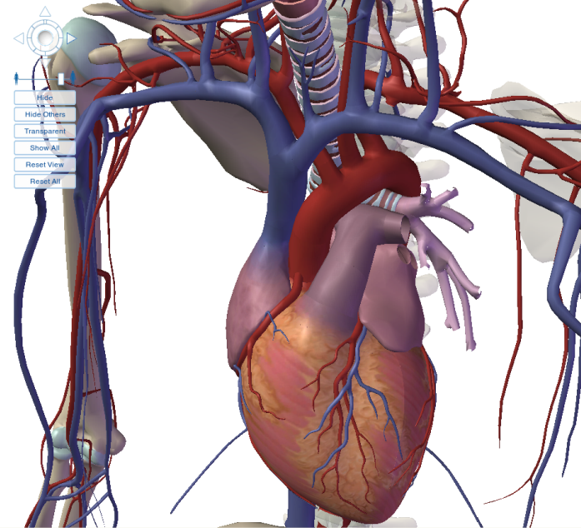
Heart, great vessels
Circulation in axilla and upper arm
Axillary artery & vein
Subclavian artery & vein
Brachial artery & vein
Left bronchus
Pulmonary artery
Notes:
Anterior view of heart vessels
1st major distribution to heart it self, head and neck and to upper limbs
Then aorta descends and enters abdominal cavity

Slide 12
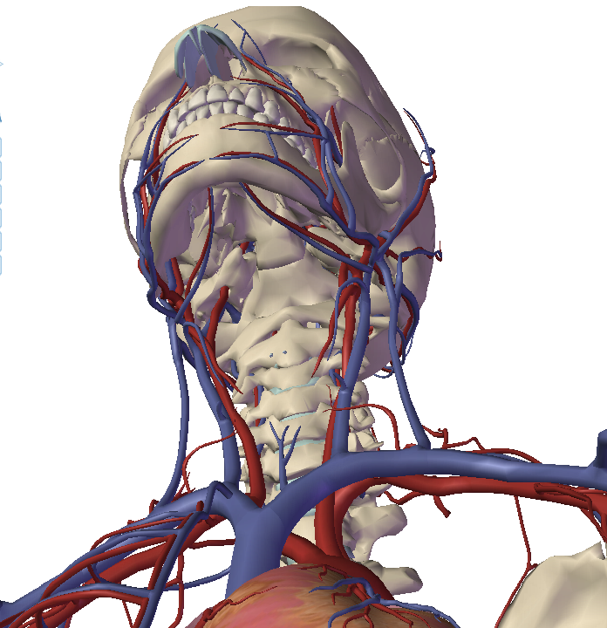
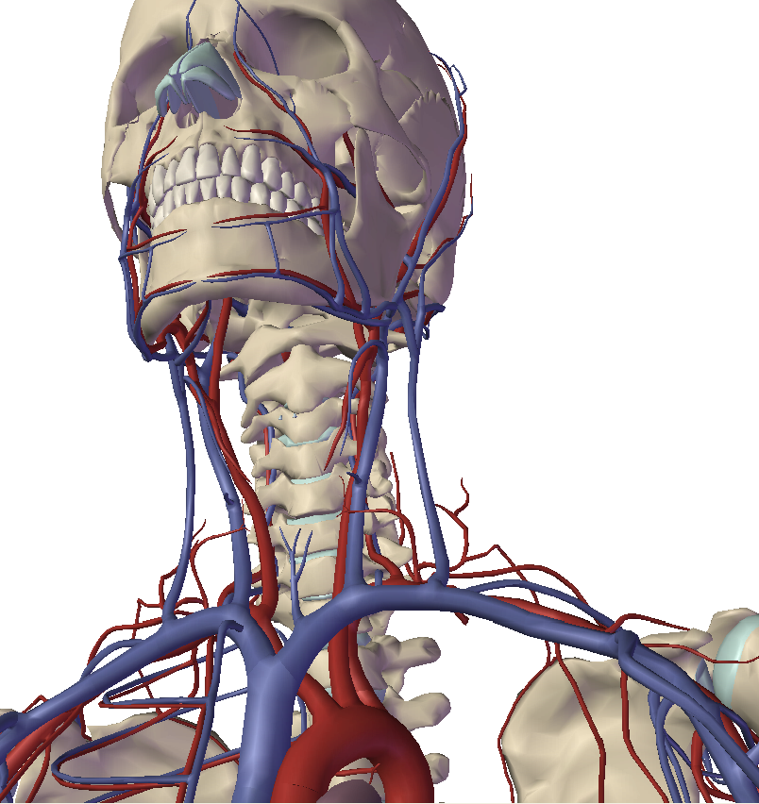
Circulation in head & neck
External & internal carotid arteries
Common carotid arteries
Arch of aorta
Notes:
Carotid system
Vertebral system taking a different route

Slide 13
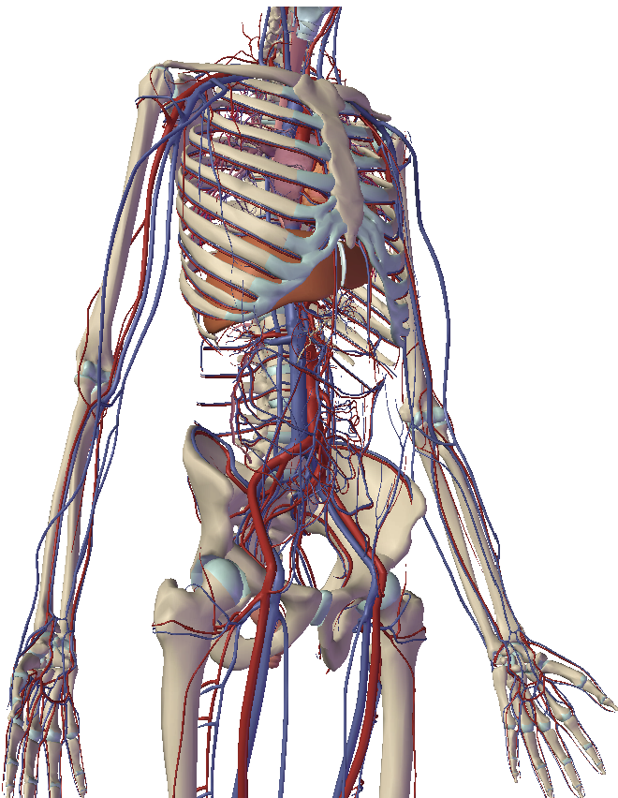
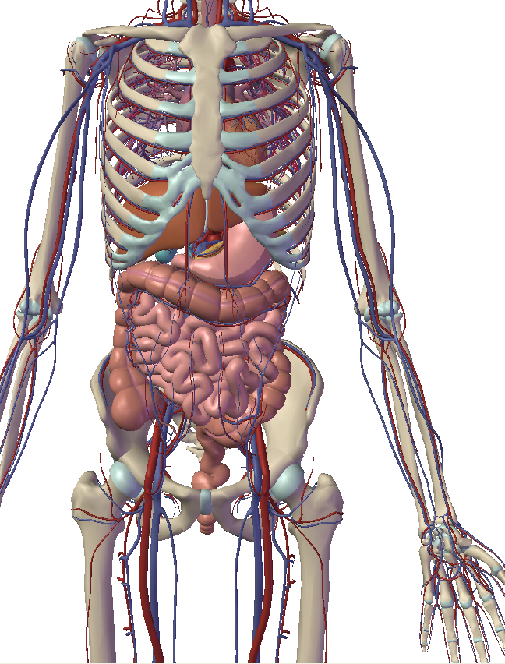
Circulation in abdomen,
upper and lower limbs
Abdominal
aorta
Radial & ulnar
arteries
Common iliac
artery
External &
internal iliac
arteries
Femoral artery
Notes:
Distribution in abdomen>
Upper gut /celiac trunk
Middle and lower parts by messentric vessels
Lower end of aorta give rise to common iliac arteries and enters the pelvic cavity
Then supplies pelvis and perineal region internal illiac arteries

Slide 14
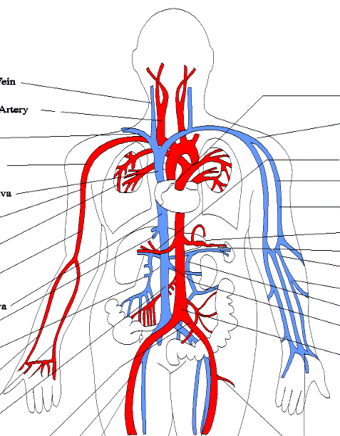
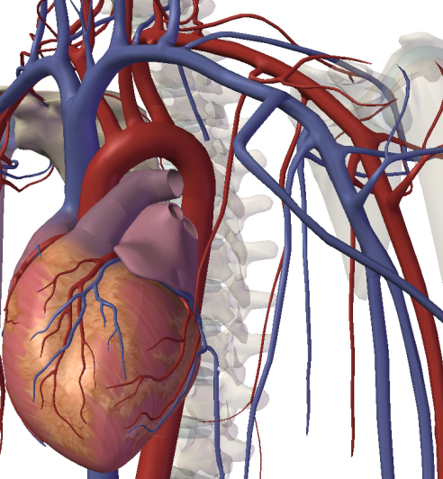
Branching patterns of arterial tree
Terminal branches
Co-lateral branches

Slide 15
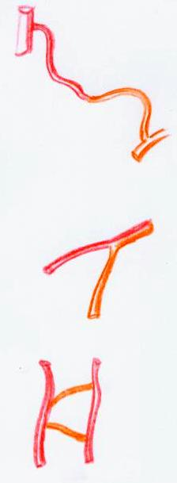
Anastomosis of arteries
End-to-end anastomosis
  Vaginal artery-ovarian artery
  Left gastro epiploic arteries
  Ulnar artery and superficial palmar branch of radial artery
Anastomosis by convergence
  Vertebral arteries forming basilar artery
Transversal anastomosis
  Between anterior cerebral arteries
  Between radial and ulnar at wrist
  Between posterior tibial and peroneal arteries

Slide 16
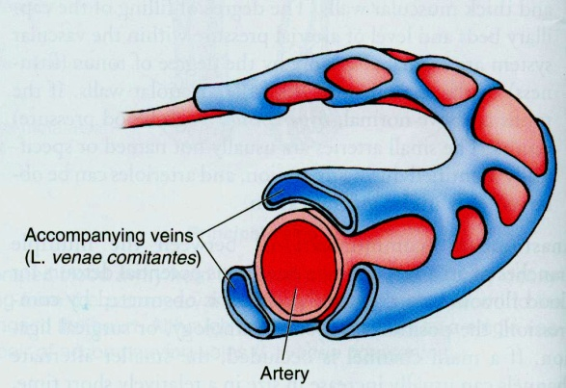

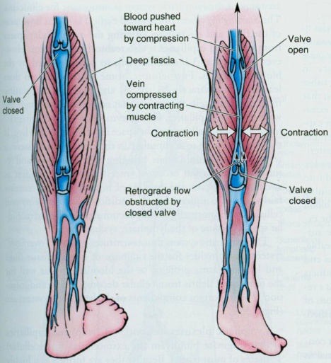
Venous system
Superficial veins
Deep veins
Venae comitantes
Valves & Venous drainage

Slide 17
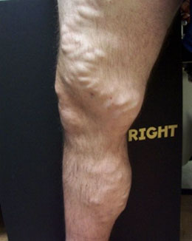
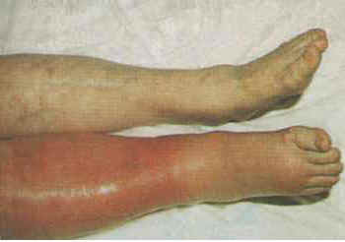
Venous system: problems
Failed superficial veins: ’’Varicosities’’
Obstructed deep veins:
’’Deep vein thrombosis (DVT)’’

Slide 18
CVS Histology

Slide 19
General arrangement of cardio-vascular tissues
(CARDIO VASCULAR TUBE)
Has three-layered structure
Tunica externa / adventitia
Tunica media
Tunica intima
’’ Tunic = coat ’’
Vasa vasorum
(Vessels of vessels)
Nervi vasorum
(Nerves of vessels)

Slide 20
General arrangement of cardio-vascular tissues
Note the changes occurring in the wall of the structures
Heart
Arteries
Capillaries
Veins
Notes:
Muscular wall shows the greatest variation
Blood pressure of 120 in major arteries to 0 once returned to right atrium

Slide 21
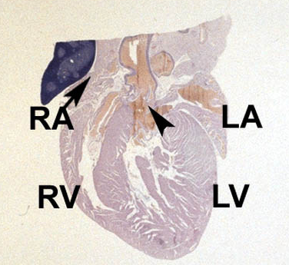
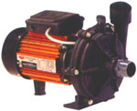
Structure for Function !
The heart is a (muscular) pump !
Notes:
Heart is a pump< theconcept
Special pump,probably the best pump that pump continuously from 3rd week of |IUL till death.

Slide 22
Heart
Cardiac wall consists of three layers:
  Endocardium (Tunica intima)
  Myocardium (Tunica media)
  Epicardium / viceral pericardium (Tunica adventitia)

Slide 23
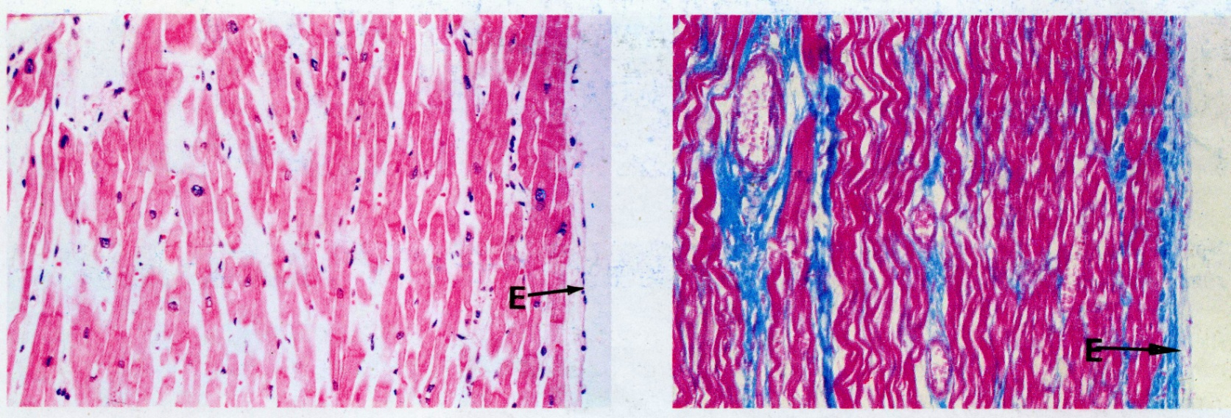
Heart
Endocardium
  Endothelium (single layer of flattened epithelial cells)
  Sub-endothelial connective tissue
Tunica intima

Slide 24
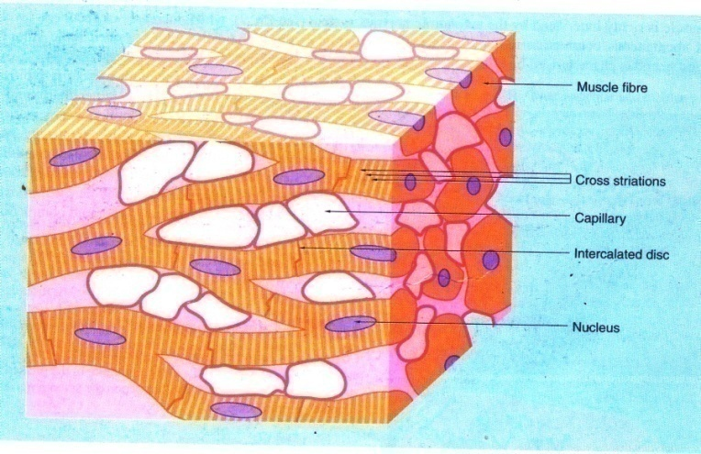
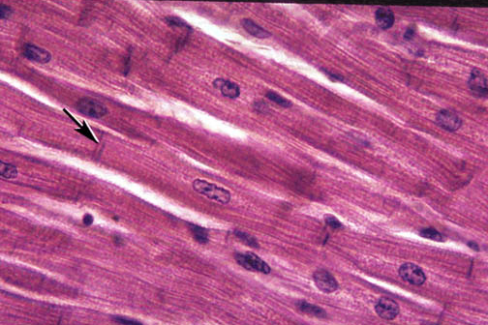
Heart
Myocardium
  Consists of cardiac muscle fibers (Cardiocytes) arranged in a network ’’ Syncytium’’
  Cardiocytes have central nucleus and are connected by junctional complexes ’’intercalated discs’’
  Mitochondria and sarcoplasmic reticulum are abundant in cytoplasm
  Muscle contractions are Strong , continuous and inherent
Notes:
Recall foundation module
Connected by intercalated disc

Slide 25
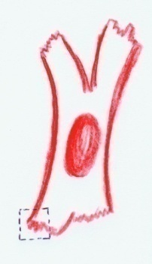
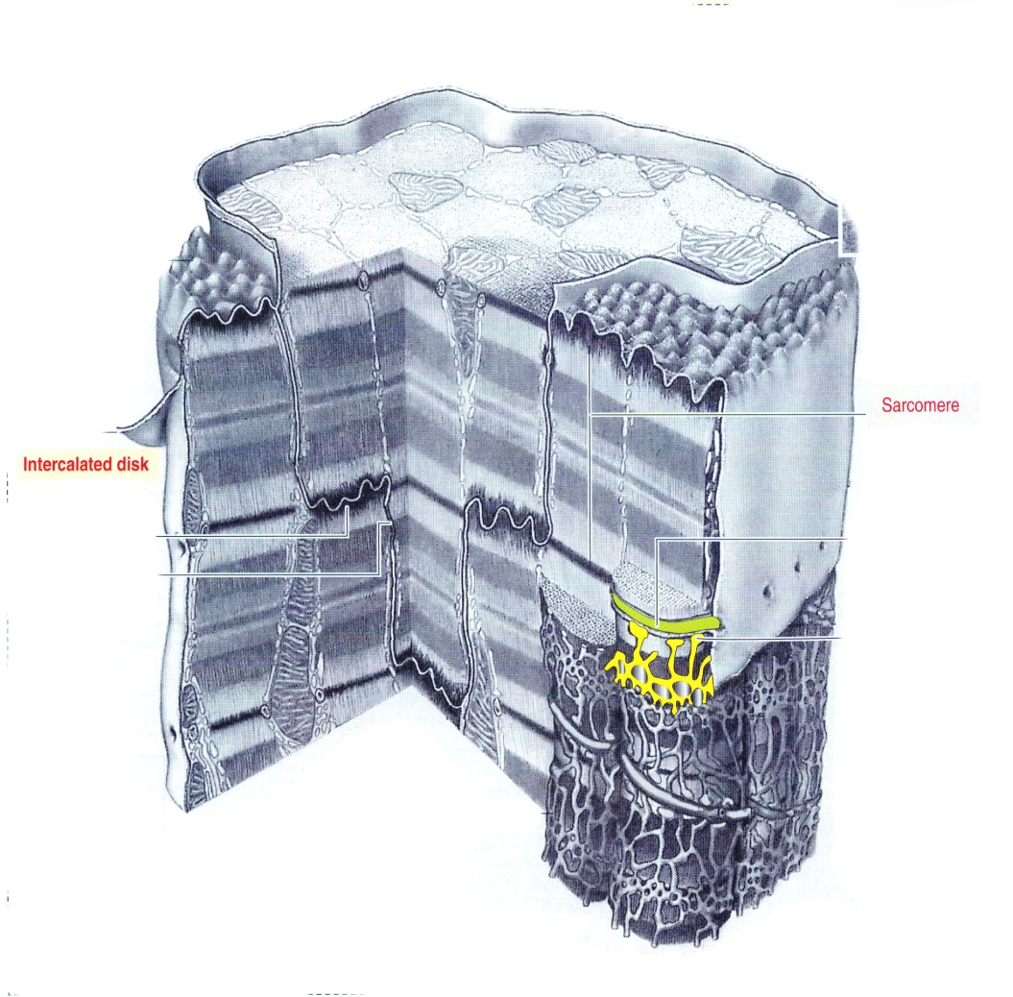
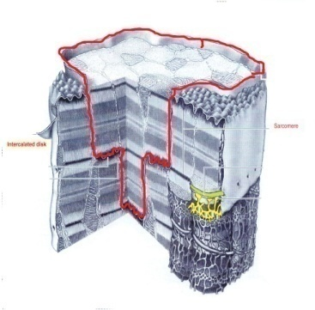
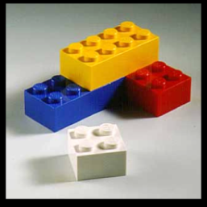
Heart
Cardiocyte-Ultra structure
Striations
Longitudinal junctional complexes
(GAP junctions)
Transverse junctional complexes
(Intercalated discs)

Slide 26
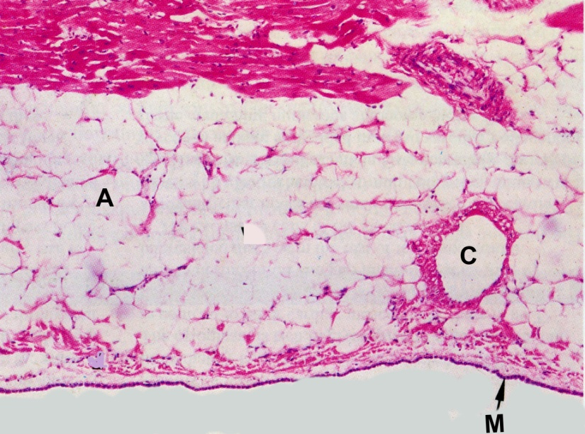
Heart
Epicardium
  Consists of flattened epithelium (Mesothelium) that secretes serous fluid into pericardial space
  Epithelium is supported by Sub-endothelial connective tissues
  Contains coronary vasculature

Slide 27
Arterial tree
Arteries conduct and distribute blood to periphery
Heart
Arteries
Capillaries
Veins

Slide 28
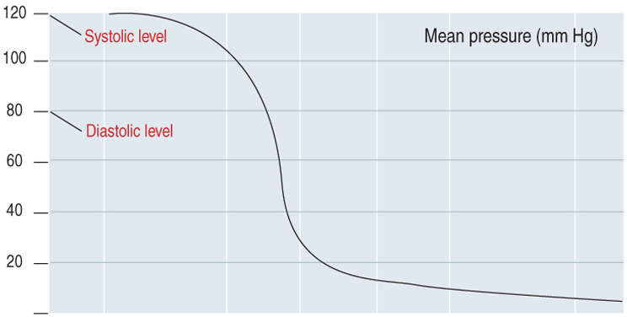
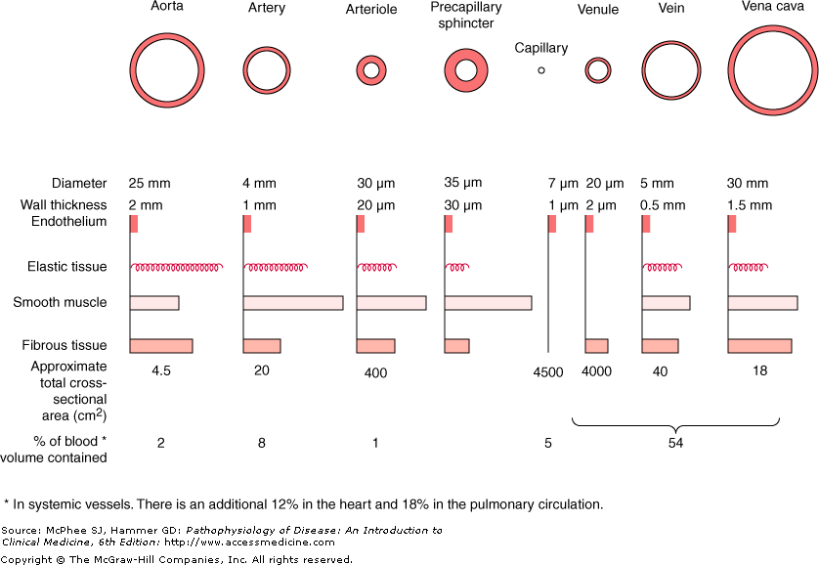
Structural adaptation for Function !
High pressure tubal system for conduction of blood to periphery
Exchange system
Low pressure tubal system for drainage of blood
Blood pressure
Vascular anatomy
Notes:
Why elastic tissues are more in EAs
So for muscular arteries

Slide 29

Arterial tree
Conform to the three-layered tissue arrangement
Main types of vessels in arterial system
  Large elastic arteries
  (Aorta , Brachiocephalic, common carotid, subclavian & common iliac arteries)
  Medium-sized muscular arteries
  (Intercostal, axillary, radial arteries)
  Arterioles

Slide 30
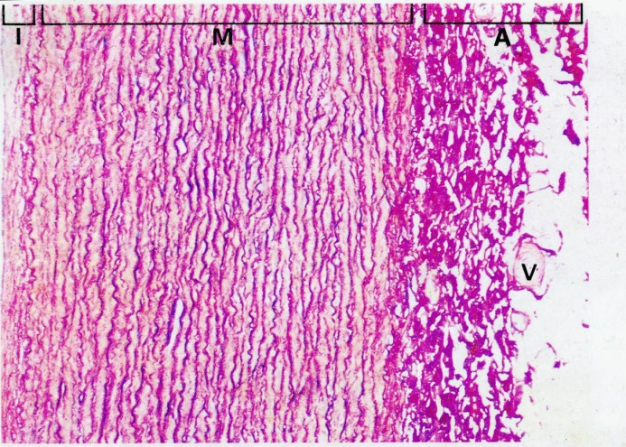
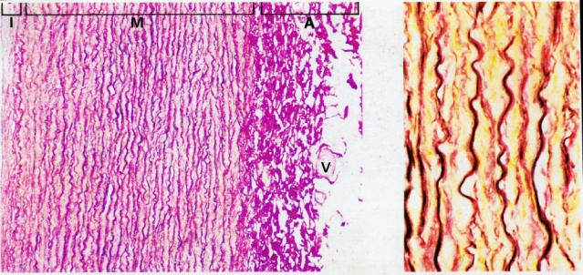
Arterial tree
Elastic arteries
  Tunica media contains large amounts of fenestrated sheaths of elastin and lesser amounts of collagen and smooth muscle cells
  Tunica adventitia contains collagen tissues

Slide 31
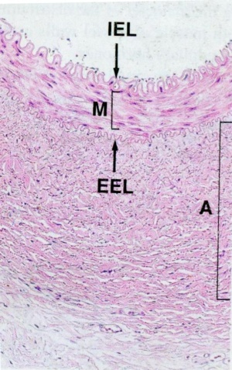
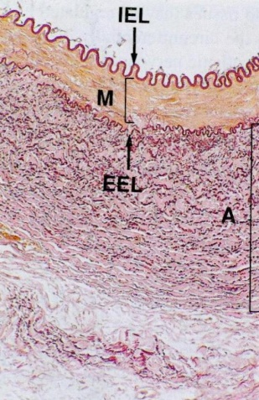
Arterial tree
Muscular arteries
  Tunica intima has three layers:
    Endothelium
    Sub endothelial connective tissues
    Internal elastic lamina (sheath of elastin)
  Tunica media has thick layer of smooth muscle cells
  Larger vessels have external elastic lamina

Slide 32
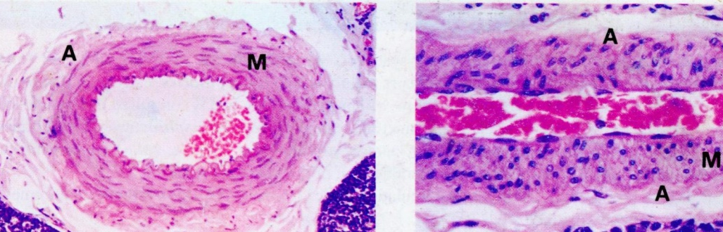
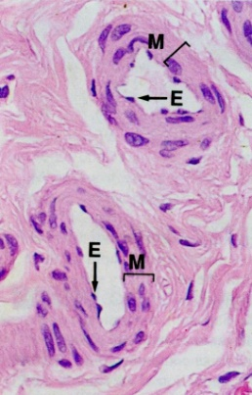
Arterial tree
Arterioles
  Arterioles are final branches of arterial system that regulate blood flow to capillary bed
  Tunica media has concentric layers of smooth muscles
  Innervated by sympathetic nerves and control the vascular tone

Slide 33
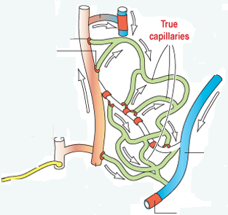
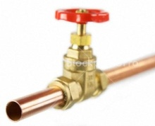
Arterial tree
Arterioles and micro circulation
Arteriloes
Pre-capillary spincters
Venule
Sympathetic nerve
Notes:
Circulation when regulated due to functional demand blood either goes through capillary bed or through shunts

Slide 34



Capillaries: the exchange compartment
  Continuation of endothelium
  No smooth muscle and adventitial layers
  Occasion pericytes are found

Slide 35

Capillaries: different types
  Continuous
  Fenestrated
  Discontinuous
Q: List the sites where different capillary types are found

Slide 36


Venous system
Veins & venules
Capillaries
Venules (Post capillary, Muscular & Collecting venules)
Veins
Has relatively Large lumen & thinner wall
Elastic and muscular components are much less prominent compared to arteries
Acts as reservoirs of blood; Capacitance vessels

Slide 37


Lymph vascular system
Reuptake excess tissue fluid that accumulates in ECS
Similar to venous system

Slide 38
Things that are good to read (know) !
Formation of Edema
Thickening of arterial walls i.e. Arteriosclerosis & Atherosclerosis
Endothelium and inflammation
Endothelium and blood coagulation
Biology of vessel formation and tumors (tumor angiogenesis )

Slide 39
References
Wheaters functional histology
Histology and cellbiology by Abraham L Kierszenbaum
Grays Anatomy
WWW.

Slide 40
The END
Thank you

