Slide 1
Diaphragm
Ajith Sominanda
Department of Anatomy
Faculty of Medicine

Slide 2
Objectives
Gross structure, function & dysfunction
1. Describe the component parts of the diaphragm and state its functions
2. Describe the nerve supply and blood supply of the diaphragm
3. State and identify structures passing through the diaphragm
including the vertebral levels
4. Use the knowledge of Anatomy in examining the respiratory system
5. State and describe the common clinical problems of the thoracic cavity
6. Clinical correlations of diaphragm related to respiration
Development
1. Development of the respiratory system and associated developmental abnormalities
2. Describe the development of the diaphragm including its congenital abnormalities

Slide 3
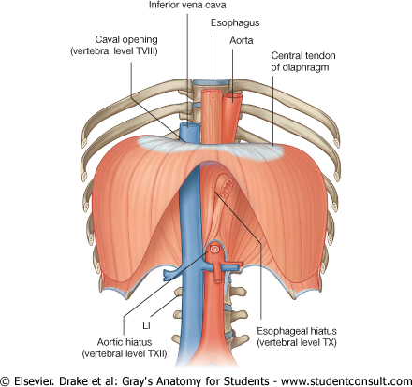
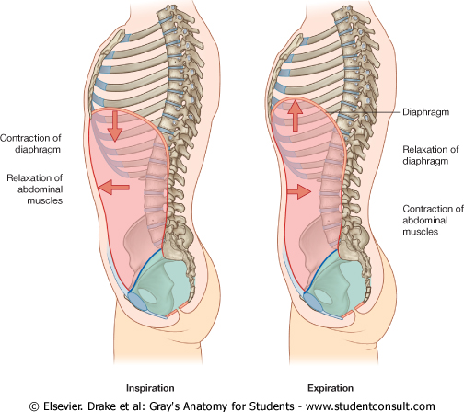
What is the Diaphragm
Fibromuscular / musculo-tendinous structure that separates the thoracic cavity from the abdominal cavity.
Main function is inspiration
Developed from inner (transversus) layer of body wall muscles

Slide 4
Other diaphragms in human body
Floor of the mouth – Oral diaphragm
Thoracic diaphragm- The diaphragm
Floor of the pelvis – Pelvic diaphragm

Slide 5
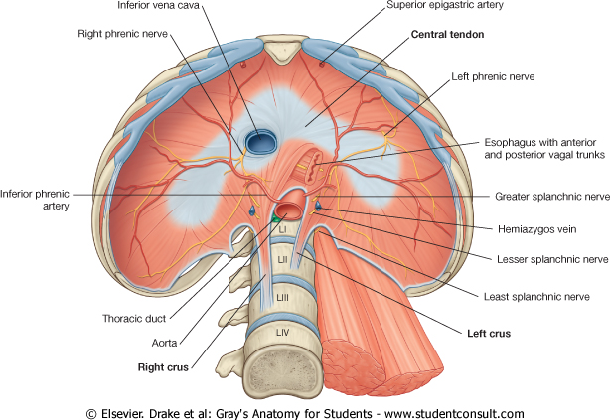
Components
Domes or Cupola of diaphragm
Tendinous part (central tendon)x
Muscular part
Base of the diaphragm

Slide 6
Components

Slide 7
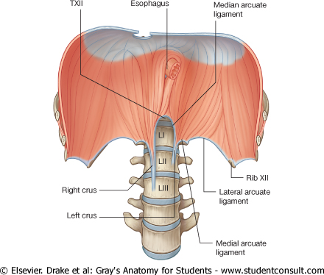
Attachments
Xiphoid process anteriorly (T8-T9)
Costal margin of the thoracic wall
Ends of ribs XI and XII;
Ligaments & crura that span across structures of the posterior abdominal wall
Vertebrae of the lumbar region.
Median arcuate ligament
Medial arcuate ligaments
Lateral arcuate ligaments

Slide 8
Structures pass through
T8
T10
T12

Slide 9
Blood supply
Costal margin:
lower five intercostal and subcostal
arteries
Muscle fibers arising from crura:
Left & right inferior phrenic arteries from abdominal aorta
Other contributions:
pericardiacophrenic & musculophrenic from internal thoracic artery
superior phrenic from thoracic aorta

Slide 10
Nerve supply
Motor:
Phrenic nerve (C3,4,5)
Sensory (proprioceptive)
Costal margin by intercostal nerves
Central area by phrenic nerves

Slide 11
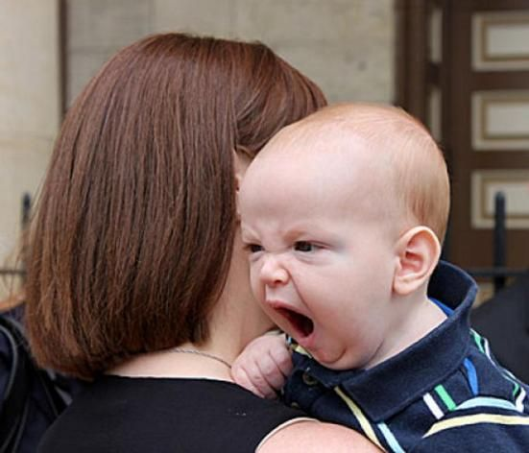
Actions
Inspiration / Breath in
Abdominal straining

Slide 12
Watch the video

Slide 13
Accessory muscles of respiration

Slide 14
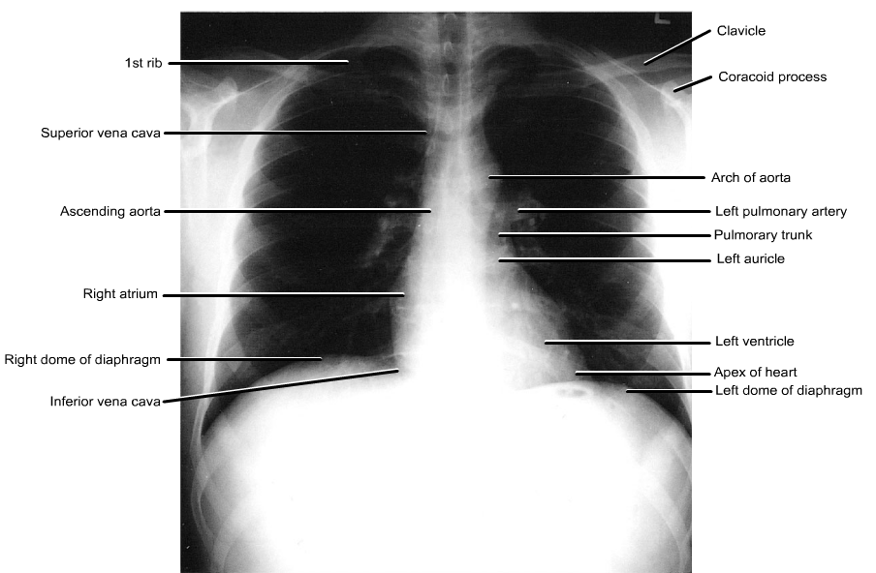
Clinical correlation: Level and the area around of the diaphragm

Slide 15
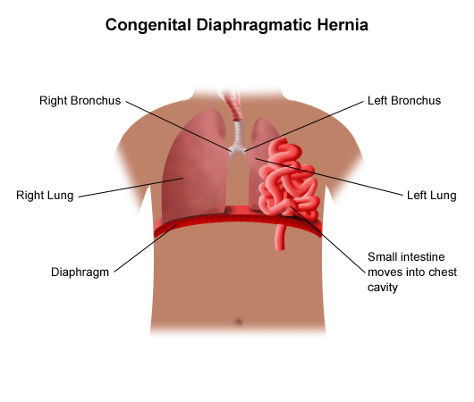
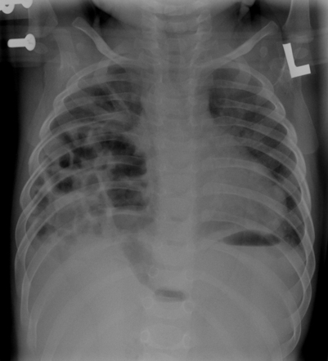
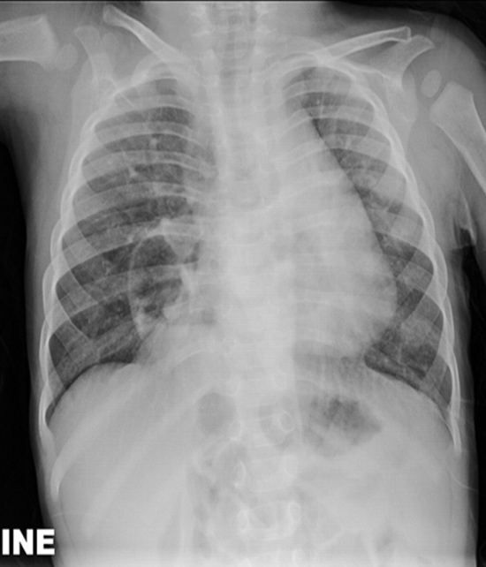
Diaphragmatic hernia
Clinical correlation: Examination of level of diaphragm
Abnormal opening in the diaphragm specially during birth i.e. congenital
Abdominal contents herniate into thorax causing respiratory problems

