Slide 1
DOSE –RESPONSE CURVES
LAKSHMAN KARALLIEDDE
OCTOBER 2011

Slide 2
When testing a potential medicine
Researchers must first show that three things are true in an experiment.
If the drug isn’t there, you don’t get any effect.
Adding more of the drug (up to a certain point) causes an incremental change in effect
Taking the drug away (or masking its action with a molecule that blocks the drug) means there is no effect.
Scientists most often plot data from dose-response experiments on a graph.
A typical “dose-response curve” demonstrates the effects of what happens (the
vertical Y-axis) when more and more drug is added to the experiment (the
horizontal X-axis).

Slide 3
One of the most important principles of pharmacology.
INVALUABLE TOOL FOR RESERACH
CONCEPT
Refers to the relationship between some effect—e.g. lowering of blood pressure—and the amount of a drug.
Scientists consider these curves important because these mathematical relationships signify that a medicine is working according to a specific interaction between different molecules in the body.

Slide 4
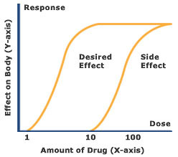
Dose-response curves determine how much of a drug (X-axis) causes a particular effect, or a side effect, in the body (Y-axis).

Slide 5
A hypothetical dose-response curve has features that vary
potency (location of curve along the dose axis)
maximal efficacy or ceiling effect (greatest attainable response)
slope (change in response per unit dose).
Biologic variation (variation in magnitude of response among test subjects in the same population given the same dose of drug) also occurs.
Graphing dose-response curves of drugs studied under identical conditions can help compare the pharmacologic profiles of the drugs
This information helps determine the dose necessary to achieve the desired effect.

Slide 6
Dose-response, which involves the principles of pharmacokinetics and pharmacodynamics, determines the required dose and frequency as well as the therapeutic index for a drug in a population.
The therapeutic index (ratio of the minimum toxic concentration to the median effective concentration) helps determine the efficacy and safety of a drug.
Increasing the dose of a drug with a small therapeutic index increases the probability of toxicity or ineffectiveness of the drug.
However, these features differ by population and are affected by patient-related factors (eg, pregnancy

Slide 7
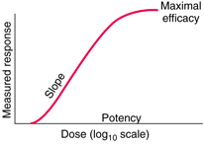
Hypothetical dose-response curve.

Slide 8
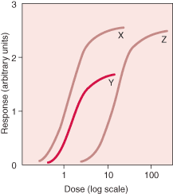
Drug X has greater biologic activity per dosing equivalent and is thus more potent than drug Y or Z. Drugs X and Z have equal efficacy, indicated by their maximal attainable response (ceiling effect). Drug Y is more potent than drug Z, but its maximal efficacy is lower.

Slide 9
A V Hill, a student of Langley's in Cambridge, explored the concentration-effect curve quantitatively in 1909, resulting in the well known Hill or Hill–Langmuir equation.
A J Clark who applied this more generally to concentration-effect curves, in what is now known as classical receptor theory.
Clark assumed that the effect of a drug is directly proportional to the concentration of drug–receptor complex and that the maximum effect occurs when all the receptors are occupied.
From this he derived the apparent dissociation constant of the interaction of a drug with its receptor.

Slide 10
Definitions
Full Agonists: Compounds that are able to elicit a maximal response following receptor occupation and activation.
Partial Agonists: Compounds that can activate receptors but are unable to elicit the maximal response of the receptor system.
Inverse agonist: an agent which binds to the same receptor binding-site as an agonist for that receptor and reverses constitutive activity of receptors. Inverse agonists exert the opposite pharmacological effect of a receptor agonist.
Competitive and Irreversible Pharmacologic Antagonists
Competitive antagonists are drugs that bind to the receptor in a reversible way without activating the effector system for that receptor. In the presence of a competitive antagonist, the log dose-response curve is shifted to higher doses (ie, horizontally to the right on the dose axis) but the same maximal effect is reached (Figure 2-5A).

Slide 11
In contrast, an irreversible antagonist causes a downward shift of the maximum, with no shift of the curve on the dose axis unless spare receptors are present (Figure 2-5B). The effects of competitive antagonists can be overcome by adding more agonist. Irreversible antagonists cannot be overcome by adding more agonist. Competitive antagonists increase the ED50; irreversible antagonists do not (unless spare receptors are present).

